Slide 1


MindCare: Online Mental Health Support System
Course: Software Engineering
Students: Abdul Rehman Shakir, Ali Husnain, Muhammad Shahzaib
University: University of Management and Technology
This presentation details the architectural design of MindCare, an online platform engineered to provide secure and scalable mental health support. We will explore the architectural decisions underpinning its development, focusing on how these choices address critical requirements for a robust and user-centric system.
Notes:
1

Slide 2

Addressing the Mental Health Access Gap
Limited Access
Geographical barriers, therapist shortages, and scheduling conflicts often prevent individuals from receiving timely mental health support.
Privacy & Stigma
Sensitive nature of mental health requires robust privacy measures and a discreet environment to overcome social stigma.
Secure Digital Platform
The imperative for a digital solution that is not only secure and scalable but also capable of delivering diverse support features.
Architectural Imperative
A well-conceived architecture is paramount to ensure the system's reliability, maintainability, and capacity to handle sensitive data effectively.
Notes:
2

Slide 3












The Critical Role of Software Architecture
Definition
Strategic Decisions
Software architecture defines the fundamental structures of a software system, outlining its components, their relationships, and the principles guiding its design and evolution.
Architectural choices are crucial as they impact every aspect of the system, from development to deployment and future enhancements.
Modularity
Scalability
Promotes independent development and deployment of components, simplifying complexity and fostering innovation.
Ensures the system can gracefully handle increasing user loads and data volumes without compromising performance.
Maintainability
Security
Influences the ease with which the system can be modified, updated, and debugged over its lifecycle.
Foundation for protecting sensitive data and ensuring system integrity against potential threats.
Notes:
3

Slide 4
Exploring Architectural Paradigms
Monolithic
1
A single, unified codebase where all components are tightly coupled. Simple to develop initially but challenging to scale and maintain.
Client-Server
2
Separates client-side user interface from server-side data management. Facilitates distributed computing and resource sharing.
Layered
3
Organises components into horizontal layers, each with specific responsibilities, promoting separation of concerns.
MVC
4
Divides application into Model, View, and Controller, primarily for UI-driven applications, enhancing modularity and testability.
Microservices
5
Structures an application as a collection of loosely coupled, independently deployable services, enabling agility and scalability.
Notes:
4

Slide 5

Architecture Rejection: Monolithic
  Tight Coupling: Interdependencies hinder independent development and deployment.
  Poor Scalability: Scaling requires replicating the entire application, which is inefficient.
  High Maintenance Risk: Changes in one part can inadvertently affect others.
  Limited Modularity: Difficult to isolate and test individual components.
Notes:
5

Slide 6
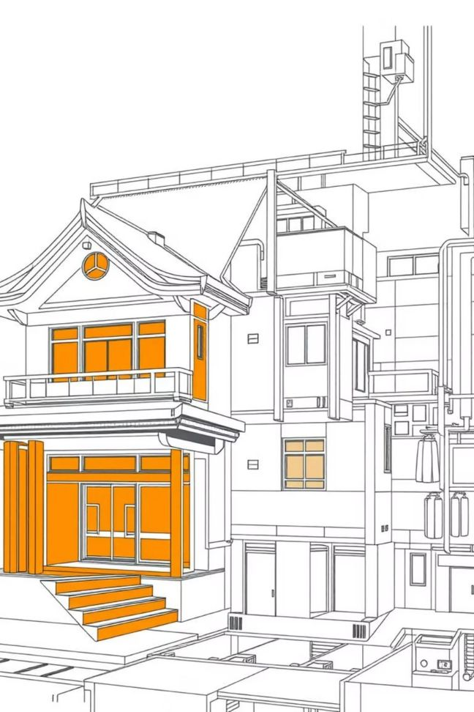
Architecture Rejection: MVC
  UI-Centric Design: MVC is primarily designed for user interface-driven applications, not backend service architecture
  Limited Scalability: Difficult to scale individual components independently
  Insufficient for Complex Services: Does not adequately support multiple backend services like authentication, chat, and AI analysis
  Monolithic Tendency: Often leads to tightly coupled components, limiting modularity
Notes:
6

Slide 7

Architecture Rejection: Microservices
  Over-complex for Scope: Introduces significant overhead not justified by current project requirements
  DevOps Requirement: Demands advanced DevOps practices and distributed infrastructure management
  Operational Overhead: Increased complexity in deployment, monitoring, and debugging across multiple services
  Overkill for Academic Project: Unnecessary complexity for a university-level software engineering project
Notes:
7

Slide 8

Selected Architecture: Layered Client-Server with API Gateway
MindCare adopts a Layered Client-Server Architecture augmented with an API Gateway and Service Layer. This hybrid approach leverages the strengths of established paradigms to create a system that is robust, scalable, and manageable.
Separation of Concerns
Clear division of responsibilities across layers and services ensures modularity and simplifies development.
Enhanced Security
API Gateway centralises authentication and authorisation, providing a single point for security enforcement.
Scalability & Maintainability
Independent services allow for targeted scaling and easier maintenance, reducing the risk of system-wide impacts from changes.
Real-time & AI Support
The service-oriented approach accommodates real-time communication and integrates AI processing efficiently.
Notes:
8

Slide 9

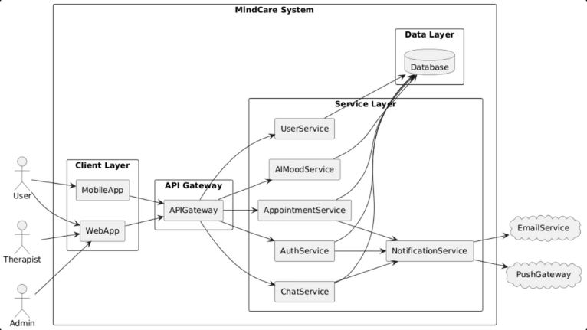
MindCare: Detailed System Architecture
The architecture diagram illustrates the distinct layers and components of the MindCare system, demonstrating how client requests flow through the API Gateway to various backend services and interact with data and external systems.
Notes:
9

Slide 10
Layer-by-Layer Breakdown
API Gateway
Client Layer
  Single entry point for all client requests.
  User-facing interfaces (Web Application, Mobile Application).
  Routes requests to appropriate services.
  Handles user interactions and presents data.
  Enforces authentication and role-based access control (RBAC).
  Communicates with the backend exclusively via the API Gateway.
  Shields internal services from direct client exposure.
Data Layer
Service Layer
  Central Database for persistent storage of all application data.
  Contains core business logic (Authentication, User Management, Chat, AI Mood Analysis, Appointment Management, Notification).
  Ensures data integrity, consistency, and secure storage of sensitive mental health records.
  Each service is modular and responsible for specific functionalities.
  Accessed only by authorised services within the Service Layer.
  Promotes independent development and deployment.
Notes:
10

Slide 11

Ensuring Security, Privacy, Scalability & Maintainability
Security & Privacy
Scalability & Maintainability
HTTPS Communication
Feature Expansion
All data in transit is encrypted using HTTPS, protecting against eavesdropping and tampering.
Modular service design allows easy integration of new features or services without disrupting existing ones.
Centralised Authentication
Increased User Load
Managed by a dedicated Authentication Service via the API Gateway, ensuring consistent and secure access control.
Individual services can be scaled independently, enabling the system to handle growth in user numbers and data.
Role-Based Access Control
Easier Maintenance
Fine-grained permissions restrict access to specific functionalities and data based on user roles (User, Therapist, Admin).
Isolation of services simplifies debugging, updates, and hot-fixes, reducing downtime and operational risks.
Secure Data Handling
Reduced Change Impact
Sensitive mental health data is stored securely in the Data Layer with appropriate encryption and access protocols.
Changes in one service are less likely to affect others, leading to a more stable and resilient system.
Notes:
11

Slide 12

Conclusion: A Resilient Foundation for MindCare
The chosen Layered Client-Server Architecture with API Gateway and a Service Layer provides a robust and adaptable foundation for MindCare. This architectural design successfully balances the need for security, scalability, and maintainability, crucial for an online mental health support system.
Architecture Rationale
System Readiness
Future Scalability
A pragmatic choice that leverages established patterns to meet complex requirements without unnecessary overhead.
The design ensures the system is ready for development, providing clear guidelines for implementation and integration.
Built to accommodate future growth and evolving requirements, ensuring MindCare remains relevant and effective.
Thank you.
Notes:
12

